Slide 1
Gramene Plant Pathways & Gene Expression Analysis www.gramene.org
www.gramene.org
Sushma Naithani, Ph.D.
Department of Botany & Plant Pathology
Oregon State University

Slide 2
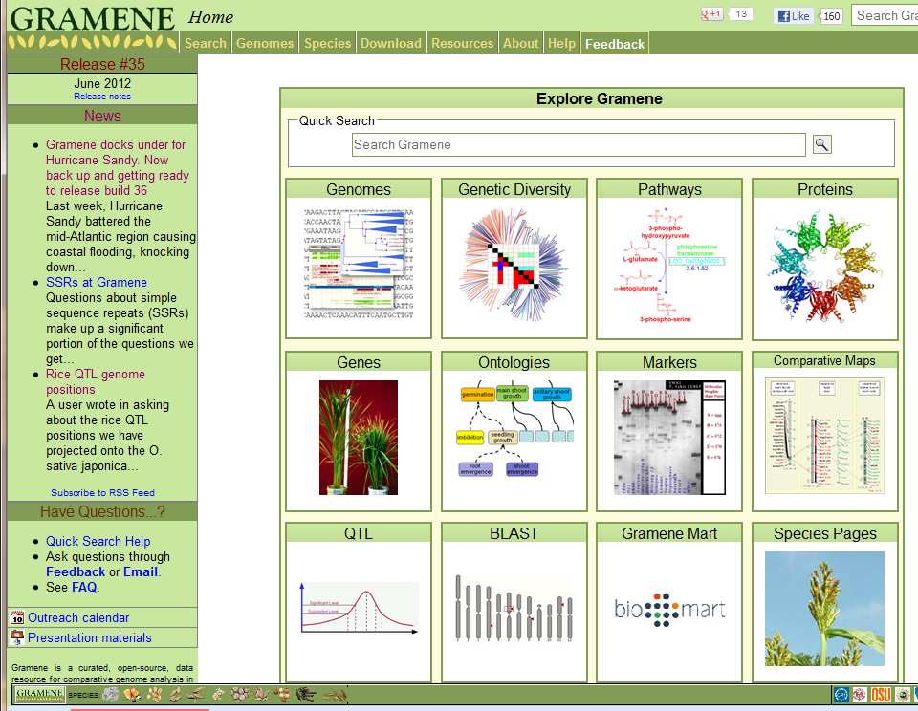
Comparative Genomics Portal

Slide 3
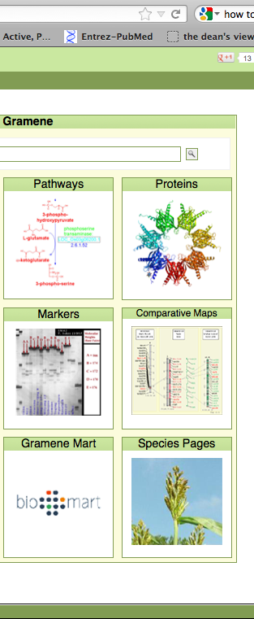
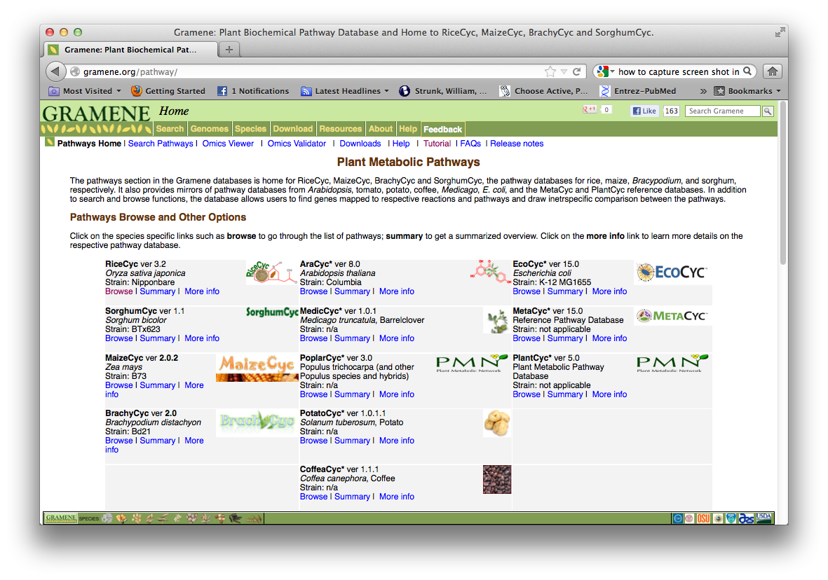
Plant Metabolic Pathways
The pathways section in the Gramene databases is home for RiceCyc, MaizeCyc, BrachyCyc and SorghumCyc, the pathway databases for rice, maize, Bracypodium, and sorghum, respectively. It also provides mirrors of pathway databases from Arabidopsis, tomato, potato, coffee, Medicago, E. coli, and the MetaCyc and PlantCyc reference databases. In addition to search and browse functions, the database allows users to find genes mapped to respective reactions and pathways and draw inetrspecific comparison between the pathways.

Slide 4
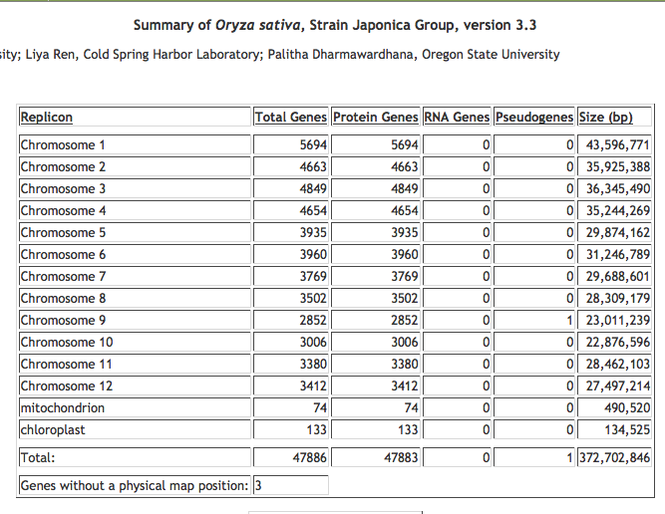
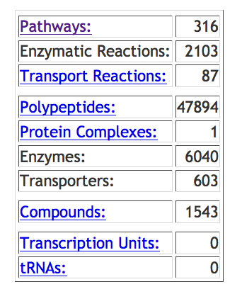

Slide 5
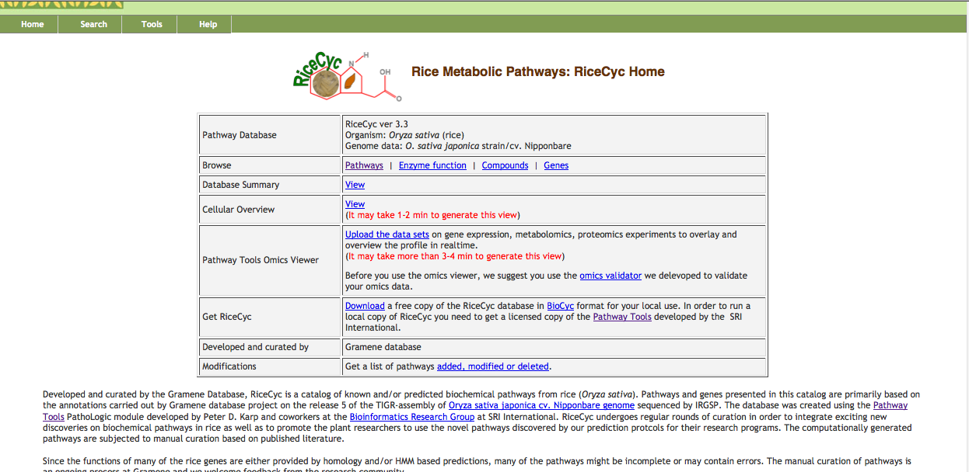
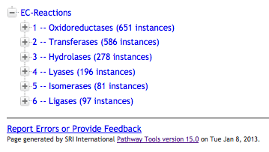
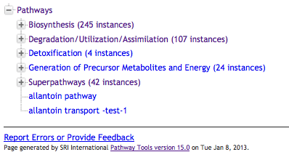
Pathway Database Browse Options
Download to get a stand alone copy of the RiceCyc database
Notes:
Conceptually, VitisCyc is a representation of the interaction between metabolites as input and output molecules of i) a biochemical reactions where enzymes serve as catalyst.
or ii) a transport reactions where metabolites are transported from one compartment to another within the cell via transporter protein(s) or ion channels.

Slide 6
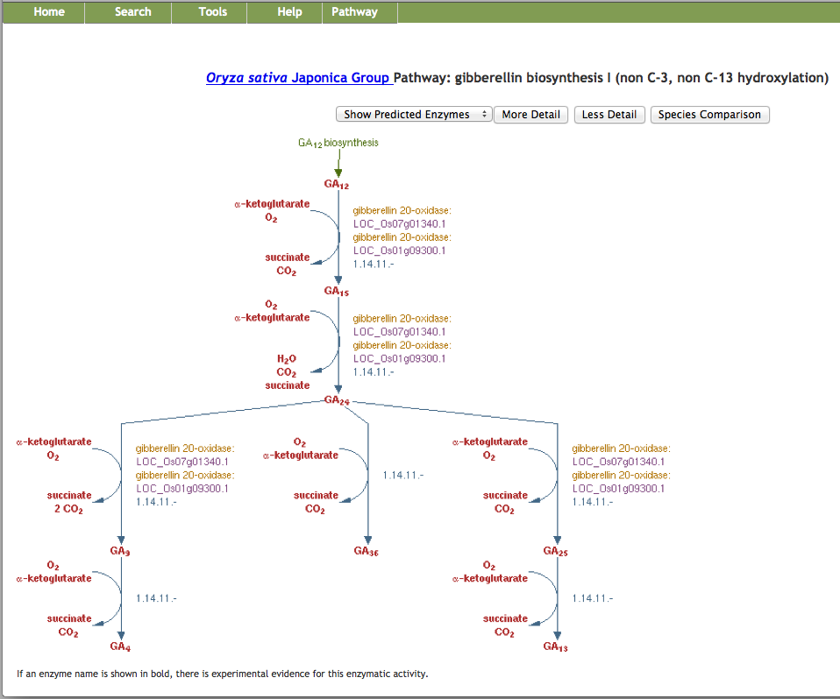
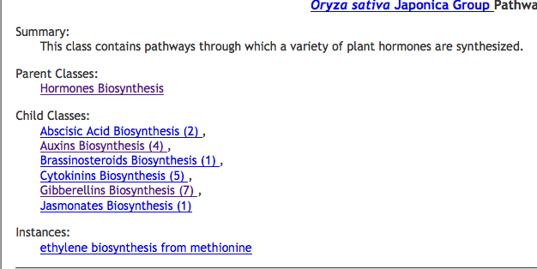
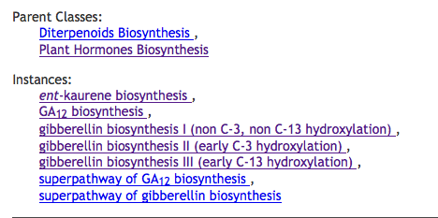
Gibberellin Biosynthesis I (non C-3, non C-13 hydroxylation)
Zoom up to chemical structures
Enzyme
Manual Curation
Evidence/support
Metabolites and small molecules

Slide 7
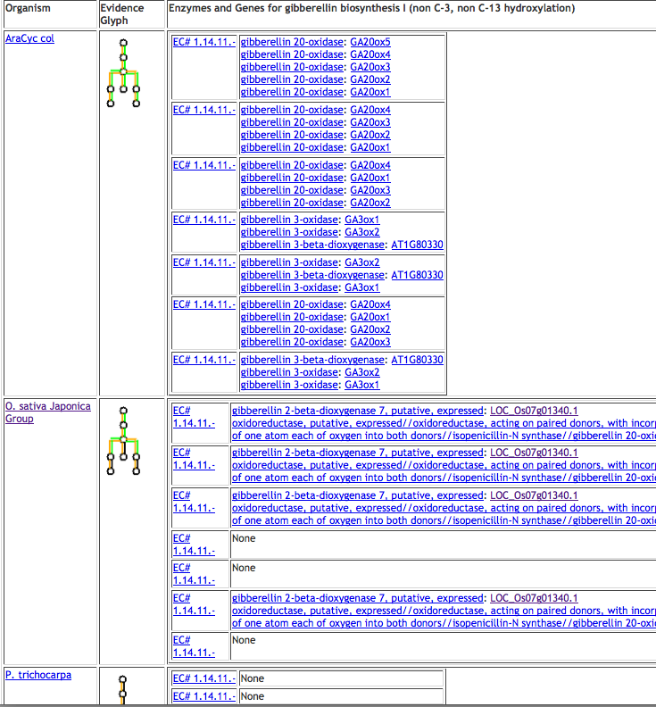
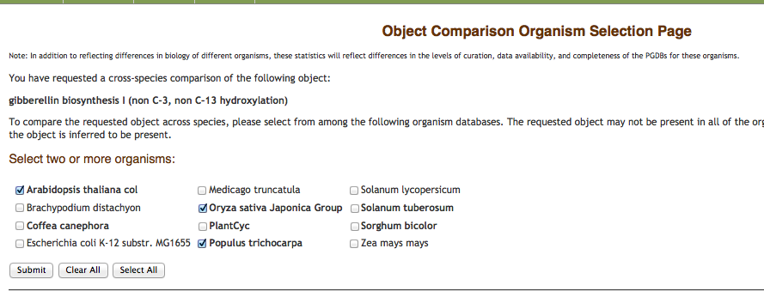
Comparison of a Metabolic Pathway Across Species
Click to visit pathway
Object Comparison Organism Selection page
Click to visit the Gene/ gene product
Click to visit the reaction

Slide 8
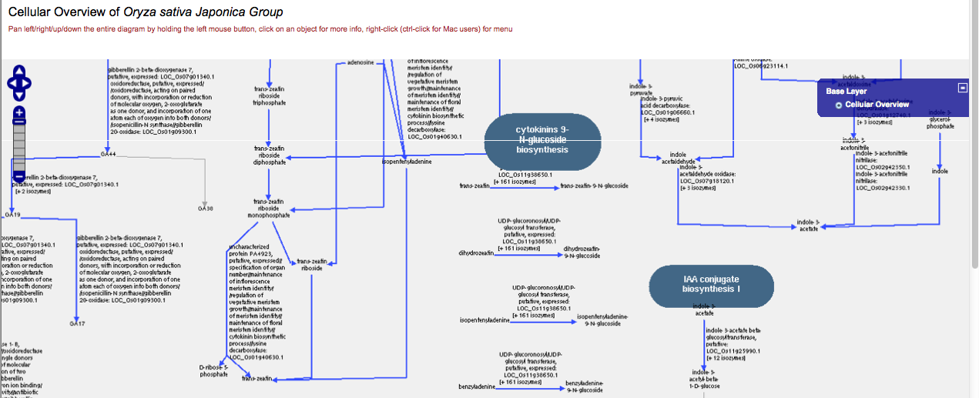
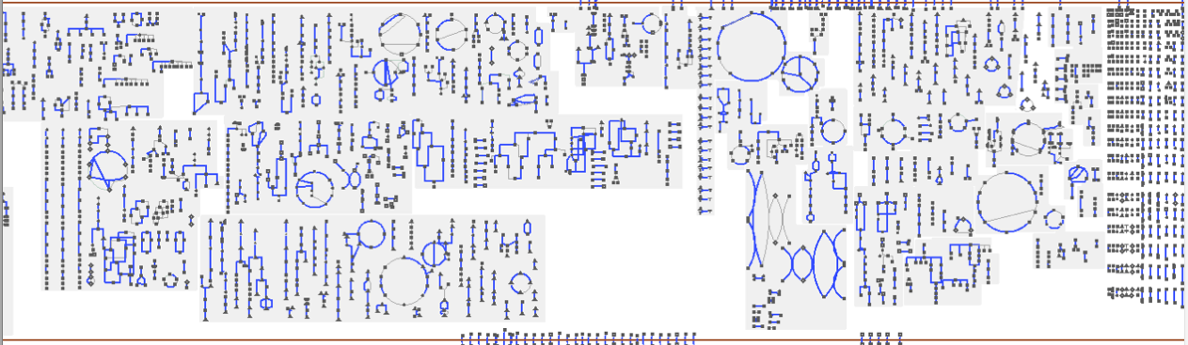
Pathway Tools Omics Viewer: Cellular Overview

Slide 9
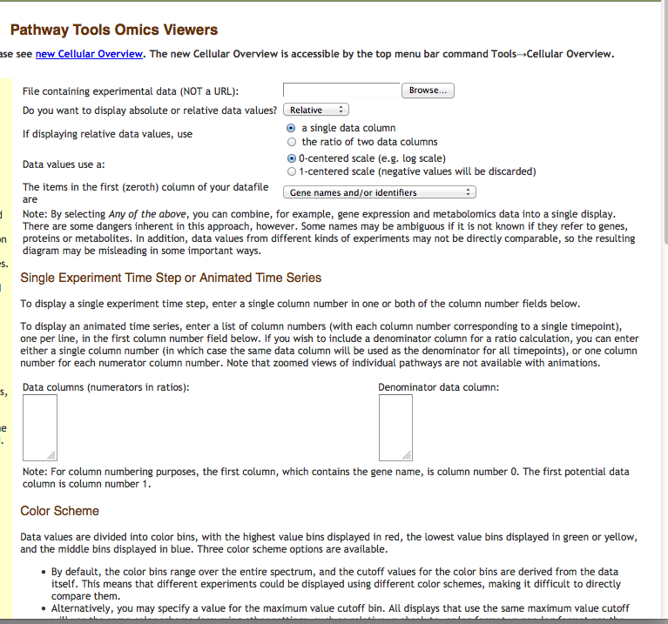
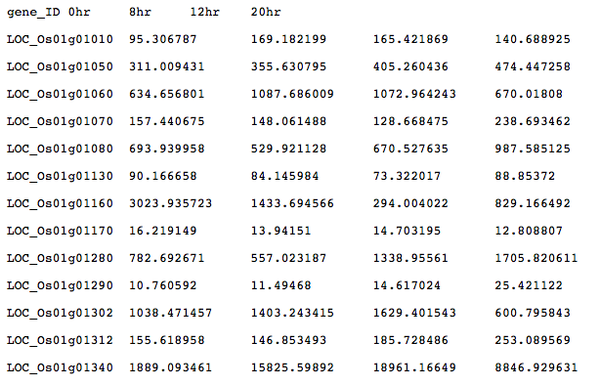
Gene Expression Analysis: Upload the Data sets
Microarray /or RNA-Seq data.
Proteomics Data
Metabolomics Data
Reaction Flux Data
Notes:
A. Microarray Expression Data and/or RNA-Seq data:
Allows interpretation of results in a pathway context and allows comparisons among various samples.
Reaction lines (and protein icons) are color-coded according to the relative or absolute expression level of the gene that codes for the enzyme that catalyzes that reaction step. Proteomics Data: Reaction lines (and protein icons) are color-coded according to the concentration of the enzyme that catalyzes that reaction step.
Proteomics Data: Reaction lines (and protein icons) are color-coded according to the concentration of the enzyme that catalyzes that reaction step.
Metabolomics Data: Compound icons are color-coded according to the concentration of the compound.
Reaction Flux Data: Reaction lines are color-coded according to reaction flux values.

Slide 10
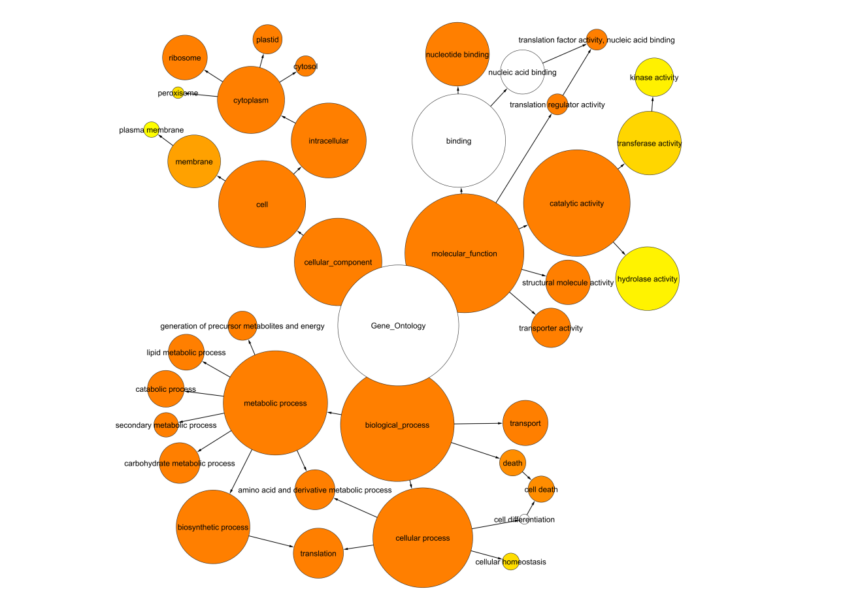
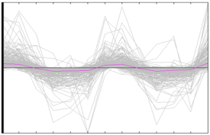
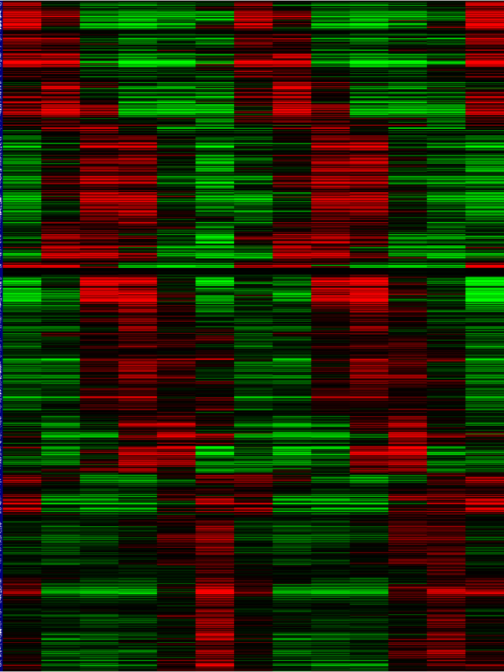
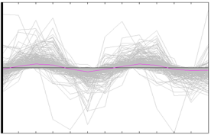
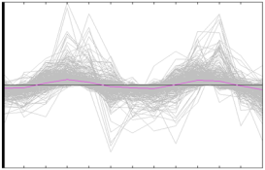
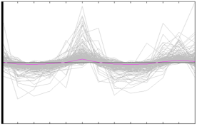
Analysis of metabolic genes under diurnal treatment
(A)
0 4 8 12 16 20 24 28 32 36 40 44 48
(B)
0 4 8 12 16 20 24 28 32 36 40 44 48
-500 0 500
Collaboration with Todd Mockler and Jaiswal Labs
Notes:
S2

Slide 11
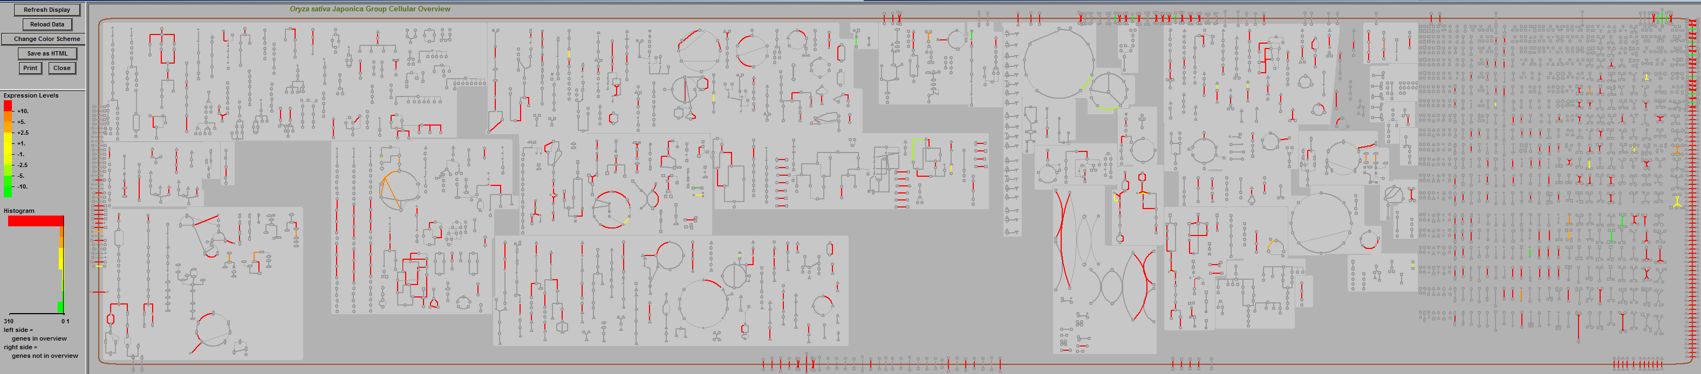
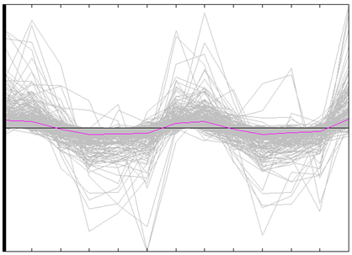
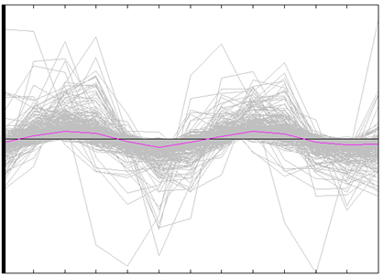
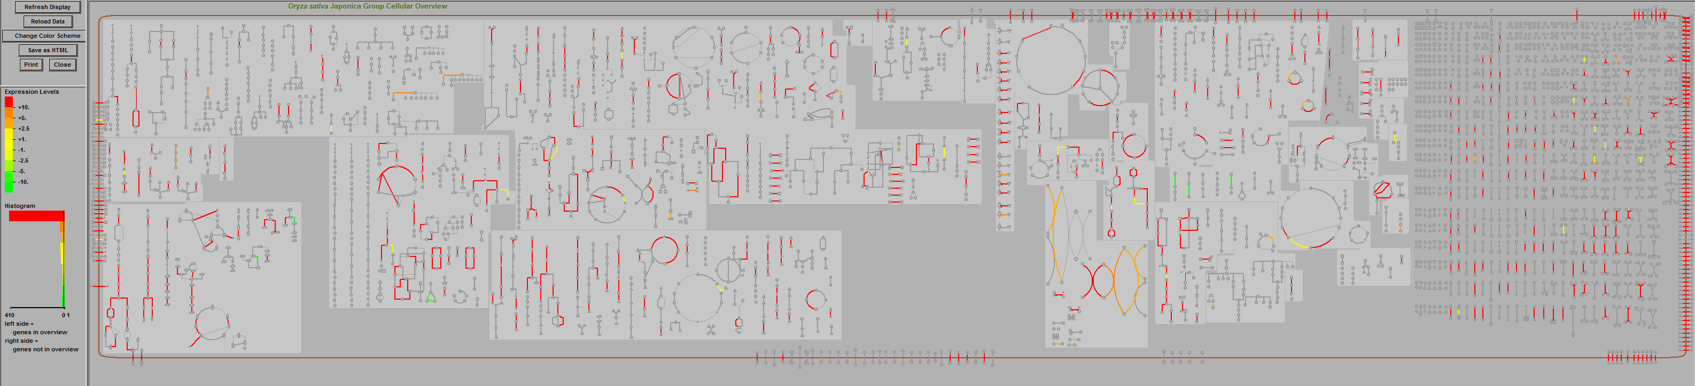
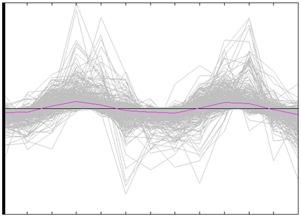
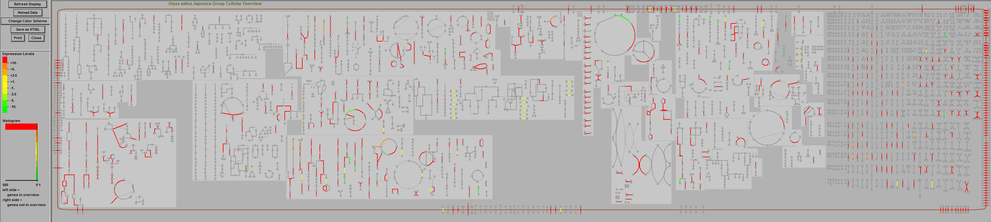
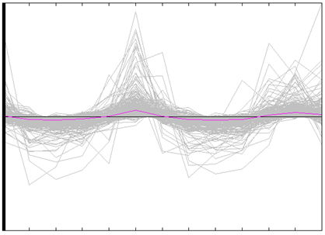
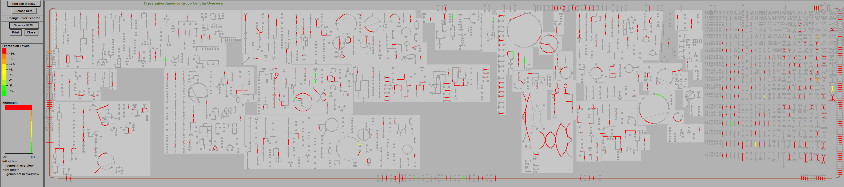
TCA
Secondary metabolism
Cofactors, electron carriers
Cell structure
0h
Polyamines
Hormones
Carbohydrates
Nucleotides
Respiration
Fatty acids and lipids
Amino acids
Transporters
8h
12h
20h
0 4 8 12 16 20 24 28 32 36 40 44 48
Notes:
Boxed pathways: (1) phenylpropanoid (lignin) metabolism, (2) cholesterol biosynthesis, (3) glycolipid and phospholipid desaturation, (4) mevalonate pathway, (5) momilactone pathways, (6) gibberellins biosynthesis, (7) IAA biosynthesis.

Slide 12

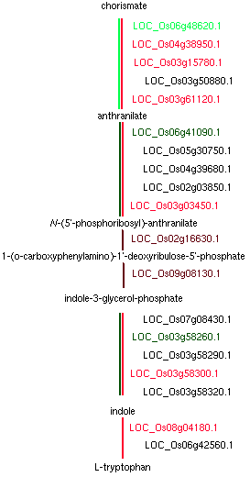
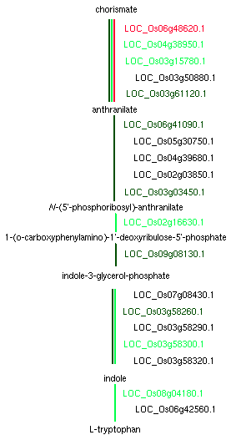
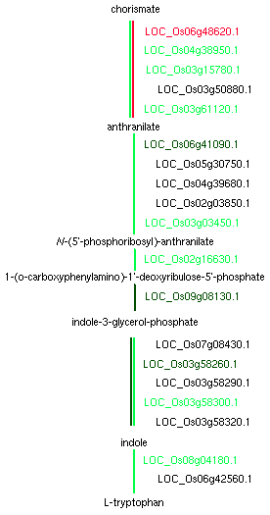
Diurnal Regulation
-100 0 100
0 4 8 12 16 20 24 28 32 36 40 44 48
0 hrs
12 hrs
24 hrs
Notes:
2

Slide 13
To be added: Desktop version view of
Pathway detail page with expression
Notes:
3

Slide 14
Genome Browser View Your Expression Data

Slide 15
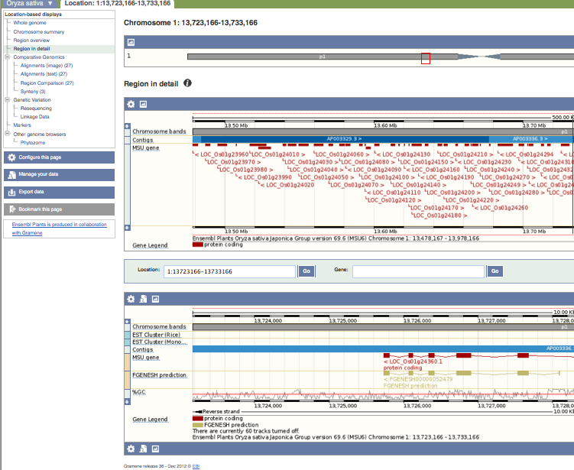
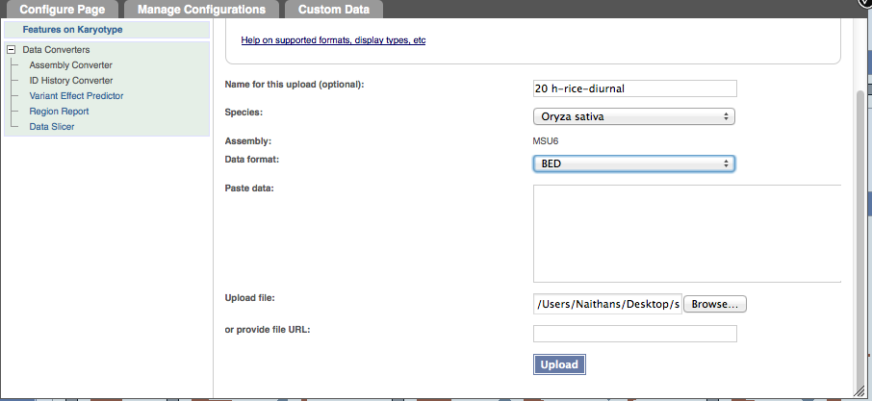
Upload, Display and Analyze your Data
BED
BedGraph
Generic
GFF
GTF
PSL
WIG
BAM
BigWig
VCF
Upper Panel
Lower Panel

Slide 16
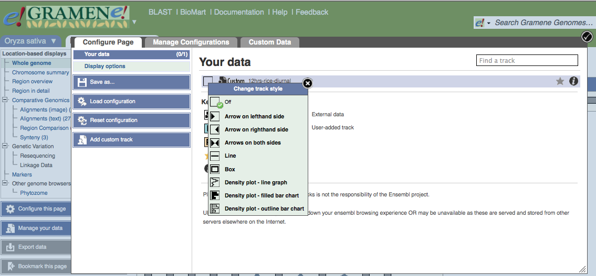
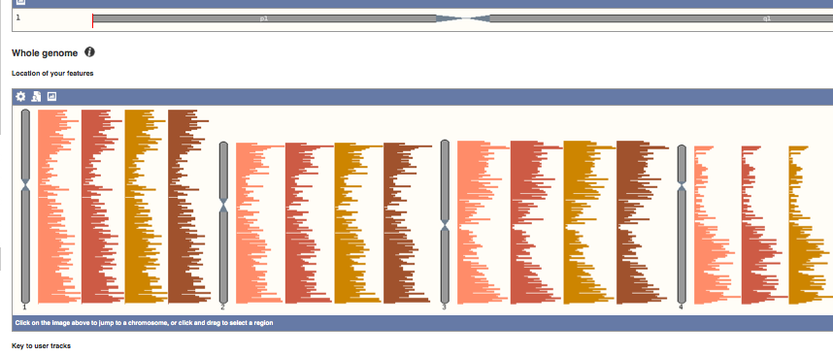
Configure & Display Data
0h 20 8h 12h

Slide 17
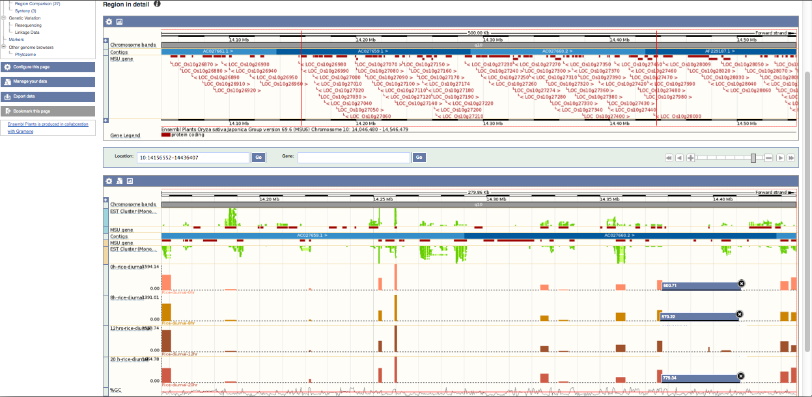
Genome Browser Display Your Expression Data

Slide 18
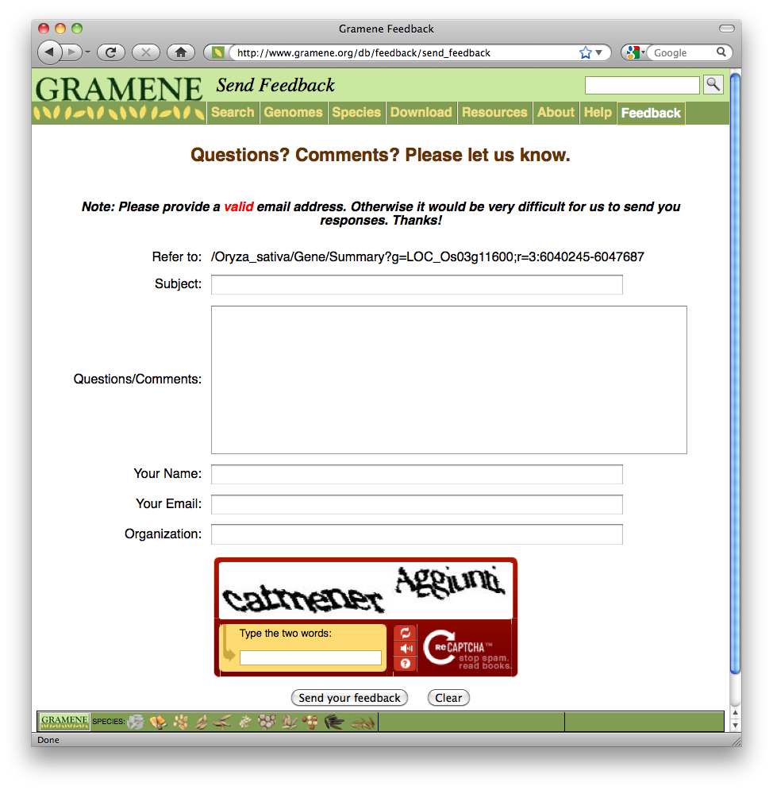
Contact Us!

Slide 19
Extra for Sushma
ftp://ftp.gramene.org/pub/gramene/outreach/pag_2013/

Slide 21
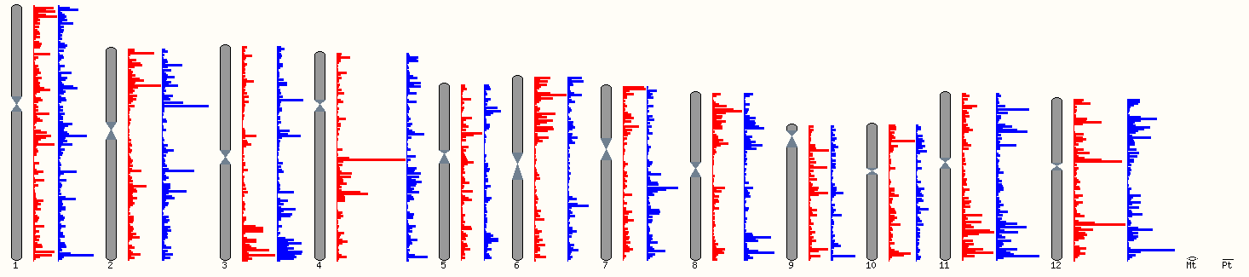
SNP Analysis: IR29/Pokkali vs. Japonica Karyoptype views
54,843
111,094
54,433

Slide 22
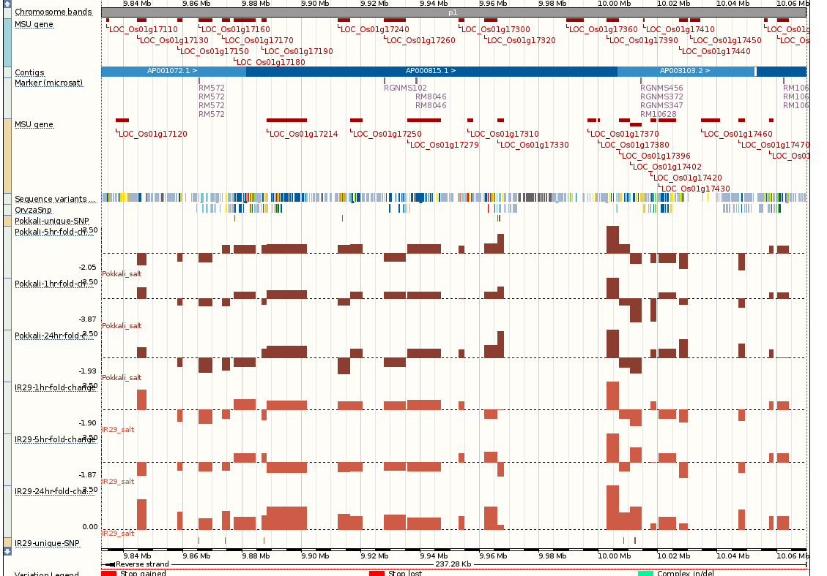
Genome Browser View Your Expression Data

Slide 24
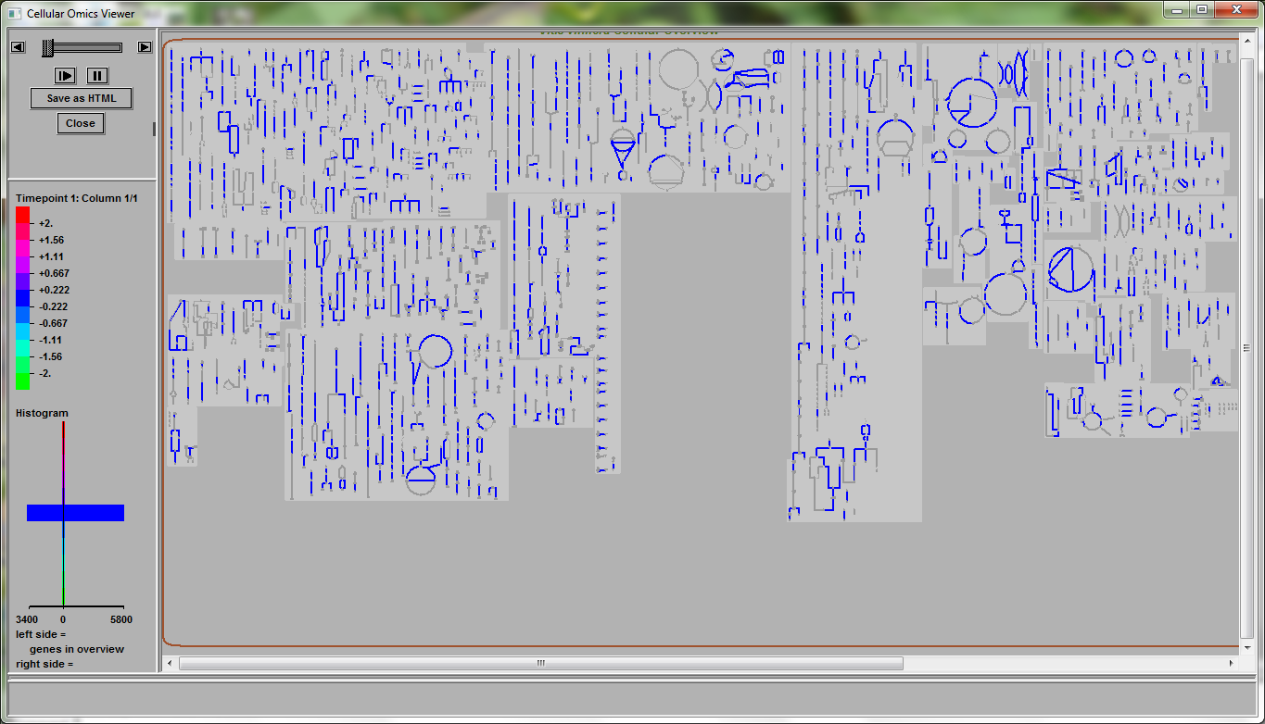
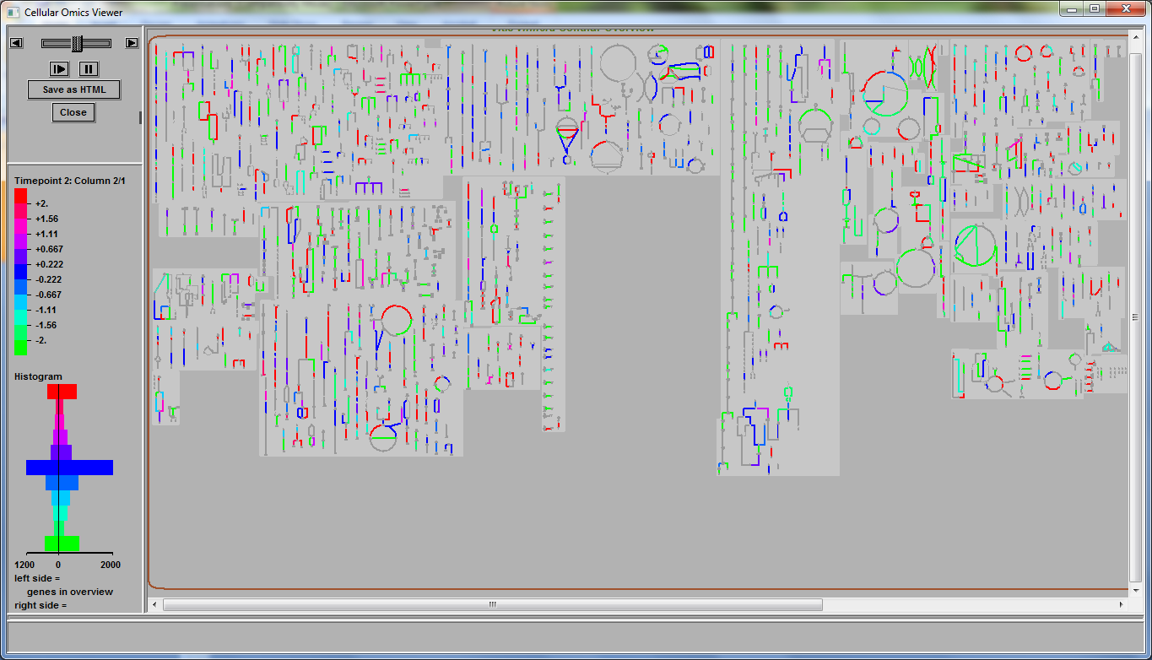
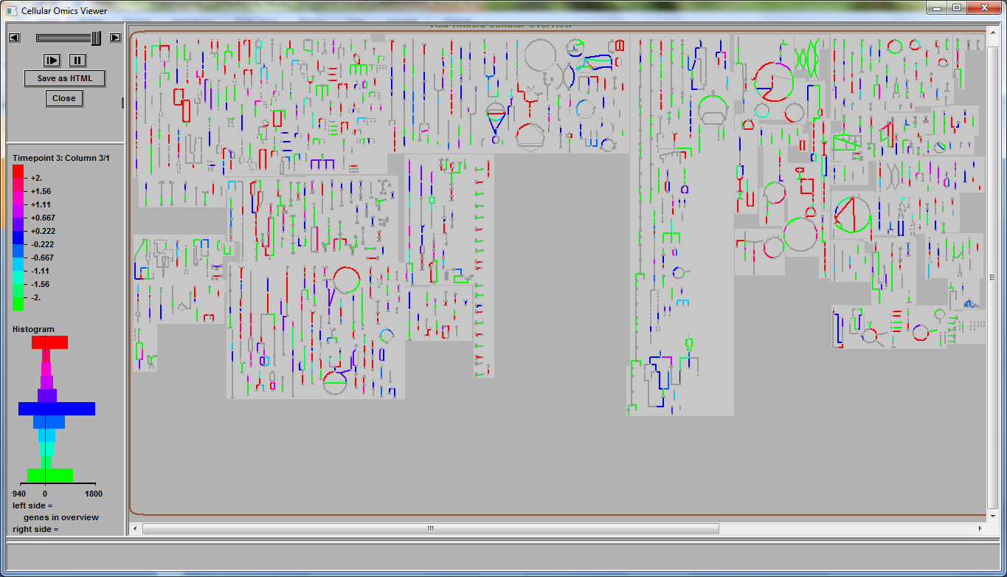

Zenoni et al RNA-seq expression data. RPKM values analyzed by looking for genes preferentially expressed in 10 and 15 weeks compared to the 5 week sample. Maximum cutoff used = 2
Lignin biosynthesis
About 9,000 genes are differentially expressed. Of these ~3400 in 5-week sample, ~1200 in 10-week and ~900 in 15-week sample mapped to the VitisCyc metabolic network.
5-week Fruit set stage
10-week Veraison stage
15-week Ripening stage

Slide 25
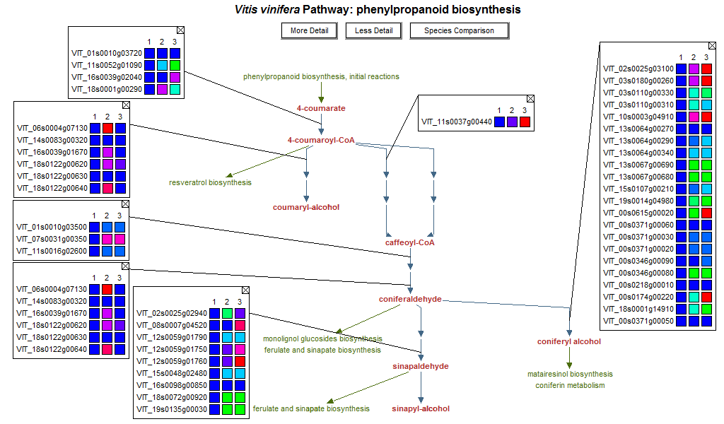
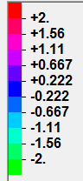

Lignin Biosynthesis
Fs V R
Fs V R
Fs V R
Fs V R

Slide 26
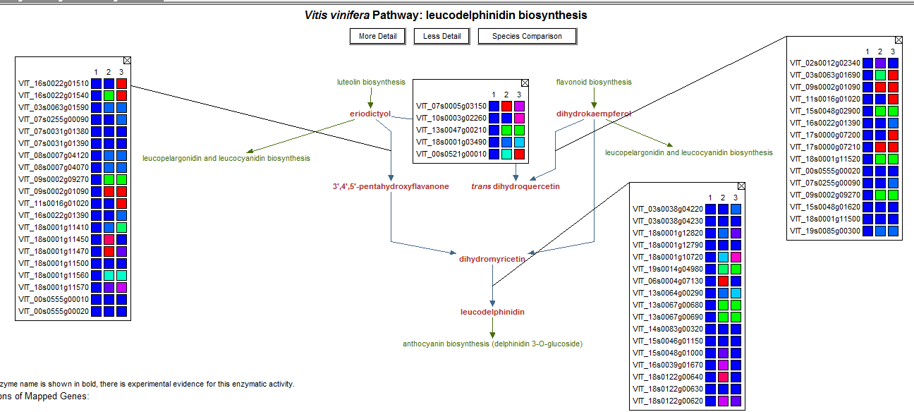
Leucodelphinidin Flavonoid Biosynthesis
Fs V R
Fs V R
Fs V R
Fs V R

Slide 27
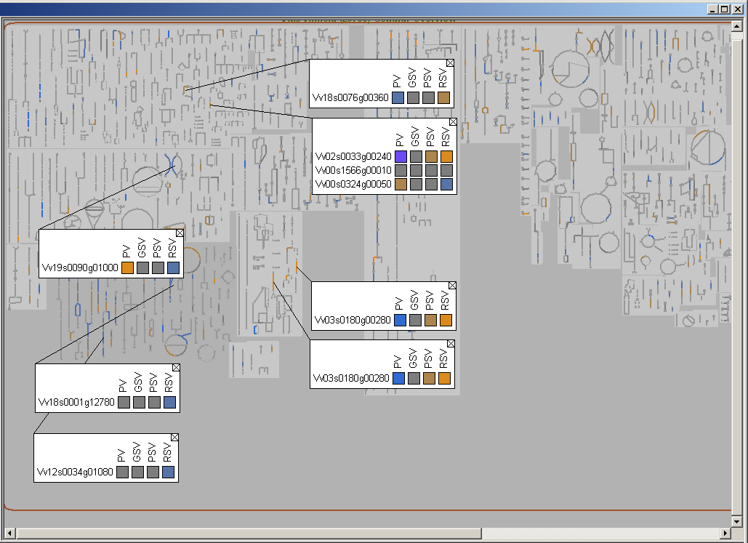
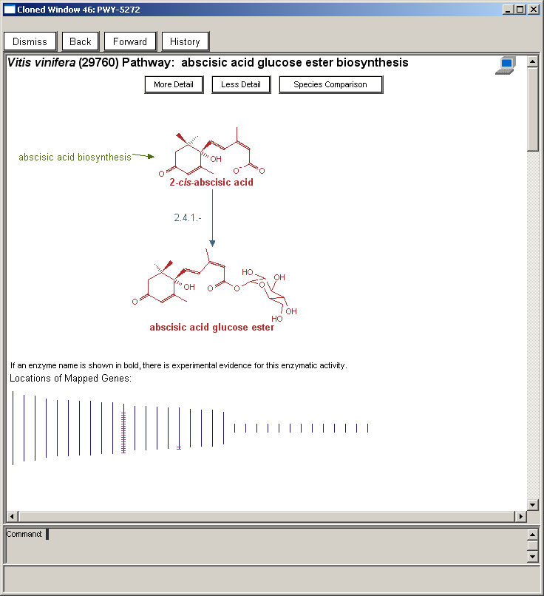

VitisCyc: Metabolic Overview of Grape Berries
Phenylethanol Biosynthesis
Anthocyanin Biosynthesis
Ascorbic acid Biosynthesis
Abscisic acid Biosynthesis
IAA conjugate Biosynthesis I
Arginine
Biosynthesis
Leucine Biosynthesis

